Slide 1
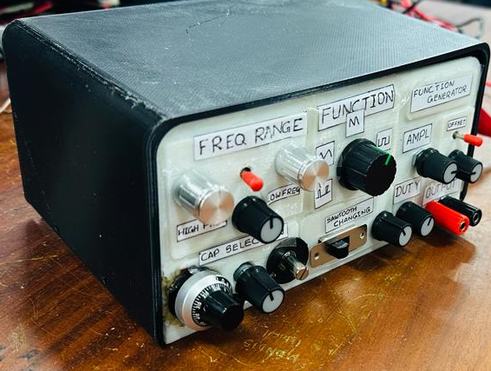
Function Generator
Team : S Nitro S
EN-2091 Laboratory Practice and Projects – Analog Project

Slide 2
Introduction
What is our implementation ?
 Functions :-
 Capabilities :-
Sine Wave
Triangular Wave
Saw-tooth Wave
Square Wave
PWM Wave ( duty cycle vary from 1% up to 99%)
Adjustable amplitude (From 0 V to 10 V)
Adjustable frequency (from 20 Hz to 20 kHz)
DC shift
This implementation is done by using op-amps, resistors, transistors, capacitors and
potentiometers.

Slide 3
Block Diagram
DC Shift
Frequency Changer
Sine Wave
PWM Wave
Amplifier Circuit
Frequency Changer
Square Wave
Triangular Wave
Output Circuit
Saw – tooth Wave

Slide 4
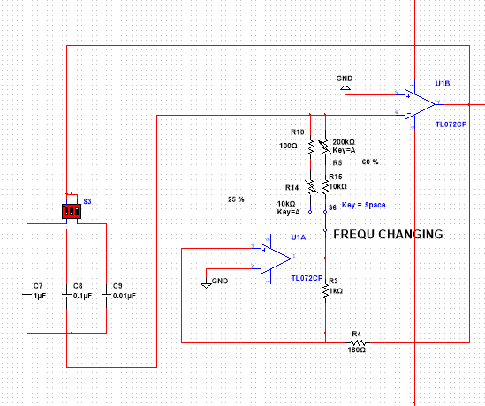
Waveform Generation
➢ Square Wave
Square wave is generating using a Relaxation oscillator circuit
The frequency of the square wave can be changed by varying the values of the potentiometers.
Components
Op-Amp - AD711JN
Slew rate – 16V/us , Unity gain bandwidth – 3MHz
power supply (3V -18V)
Potentiometers – 10 kilo ohm, 250 kilo ohm
Resistors – 100 ohm, 1 kilo ohm, 10 kilo ohm
Capacitors - 1uF , 0.1uF , 0.01uF

Slide 5
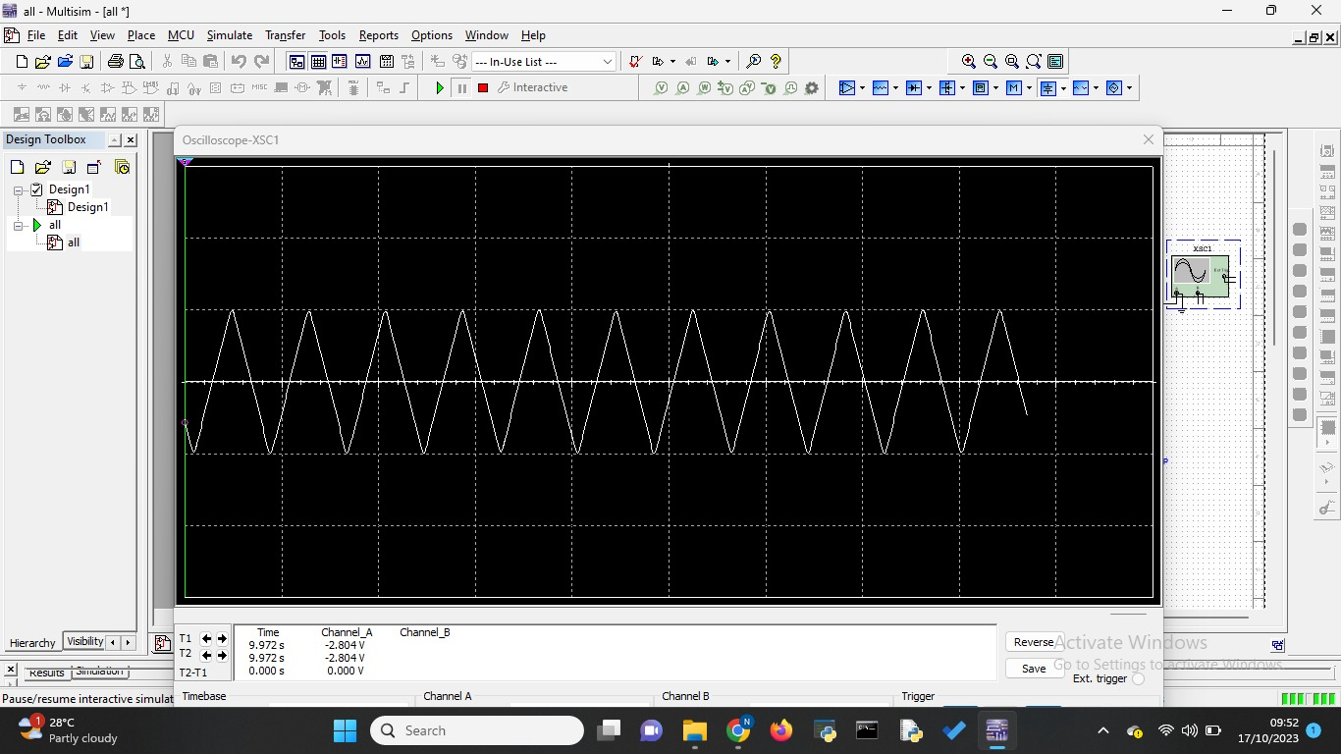
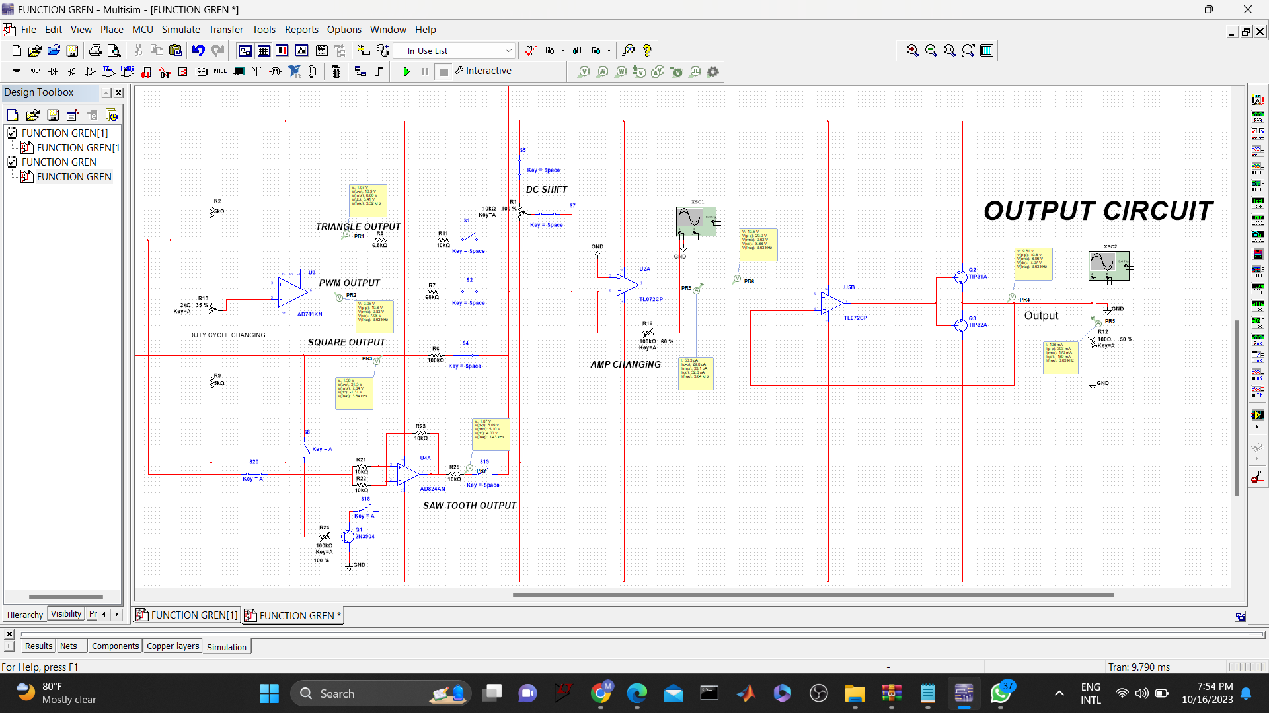
➢ Triangular Wave
The triangular is generated using a cascade combination of a Schmitt trigger circuit and an integrator.
By changing the value of the resistor R1, we can change the frequency of this oscillation.
Components
Op-Amp - AD711JN
Slew rate – 16V/us , Unity gain bandwidth – 3MHz
power supply (3V -18V)

Slide 6
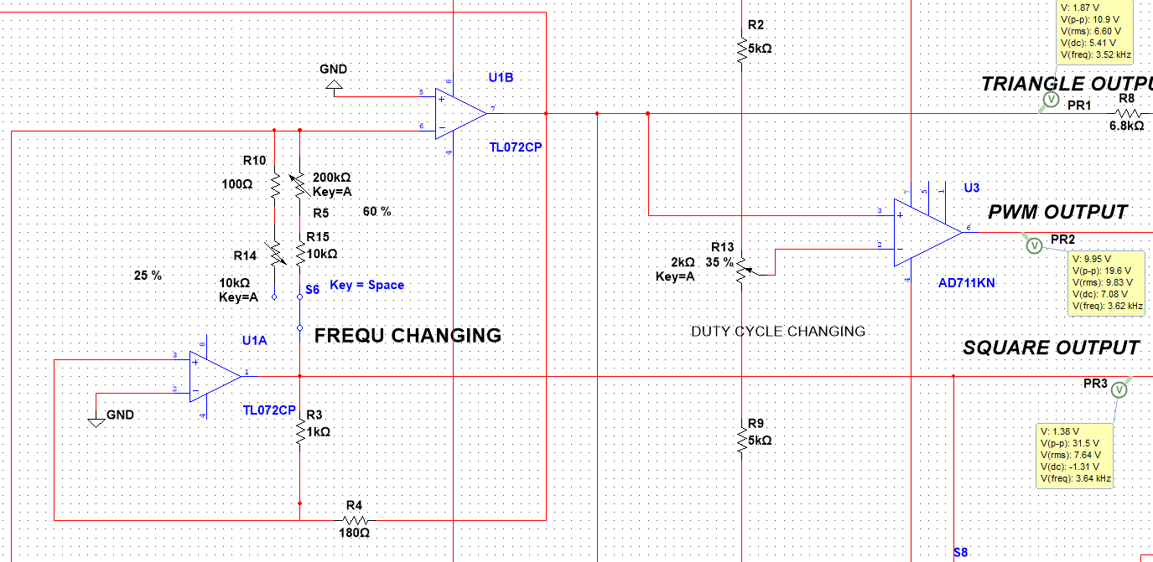
➢ PWM Wave
Generation of PWM wave can be done by comparing the triangular wave with a DC level.
The duty cycle of the PWM signal can be varied by changing the Resistance value.
Frequency of the PWM wave can be changed by changing the frequency of the triangular wave.
Components
Op-Amp - AD711JN
Slew rate – 16V/us , Unity gain bandwidth – 3MHz
power supply (3V -18V)

Slide 7
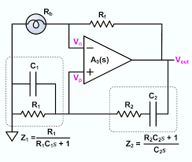
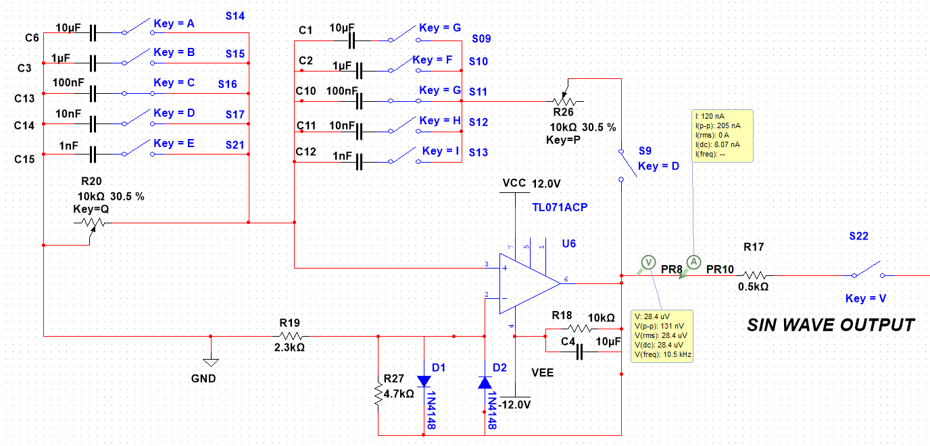
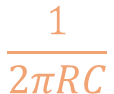
➢ Sine Wave
Wien bridge oscillator circuit is used to generate the sine wave.
The circuit generates a sine wave at the resonance frequency(fr),
f_{r} =
The frequency of the sine wave can be changed by varying the values of the two resistors or the two capacitors simultaneously.
$$\frac{1}{2πRC}$$
Components
Op-Amp - TL071CP Slew rate – 16V/us , input bias current – 5pA
power supply (3V -18V)
10 kilo ohm potentiometers – 2
Capacitors - 1 k , 10 nF , 100 nF , 1 uF , 10 uF

Slide 8
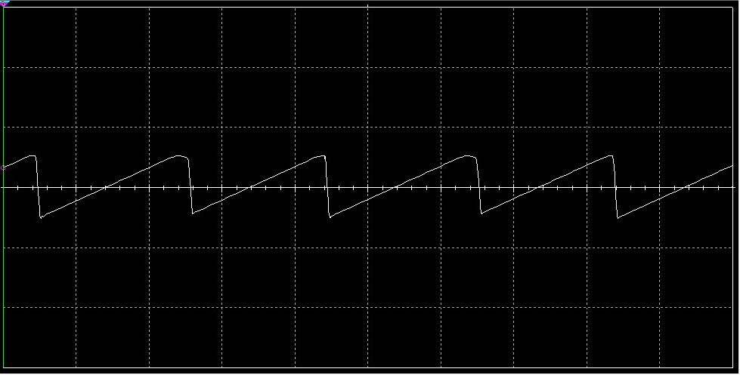
➢ Saw-tooth Wave
To generate saw-tooth waveform we connect the non-inverting terminal of the integrator to a DC voltage value.
We use the potentiometer to adjust the DC voltage.
Components
Op-Amp - TL072CP Slew rate – 20V/us , Low noise: Vn = 18 nV/√Hz
power supply (3V -18V)
2N3904 Transistor
100 kilo ohm potentiometers and 10 kilo ohm resistors

Slide 9
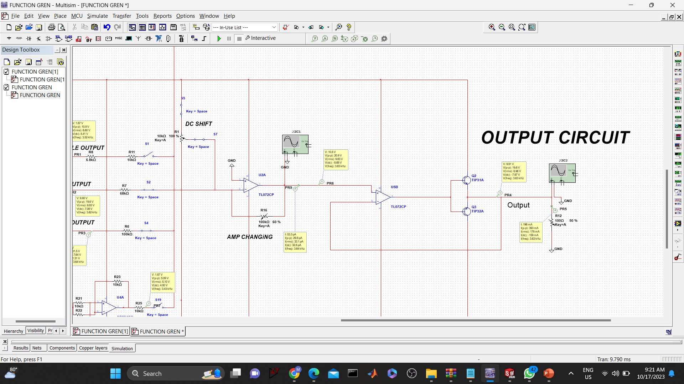
➢ Amplifying Circuit & DC shift
We provide a DC shift by using a summing amplifier circuit to the inverting amplifier op-amp
Same op-amp is used to change the gain of the signals
➢ Output Circuit within Buffer
We use a buffer circuit to isolate the output circuit and the function generator circuits while obtain a unity gain.
We use a push pull amplifier output circuit to drive a low resistance load and to amplify the current and power.

Slide 10
Frequency Ranges
• Square, Triangular, PWM & Saw-tooth
Capacitor | 250Kohm Potentiometer | 10Kohm Potentiometer
0.01uF | 12KHz – 542Hz | 41KHz – 12.5KHz
0.1uF | 1.8KHz -73Hz | -
1uF | 140Hz – 11Hz | -
• Sine Wave
Capacitor Value | Frequency Range
10uF | 20 Hz – 130 Hz
1uF | 100 Hz – 550 Hz
100nF | 500 Hz – 4.5 kHz
10nF | 4 kHz – 15 kHz
1nF | 14 kHz – 20 kHz

Slide 11
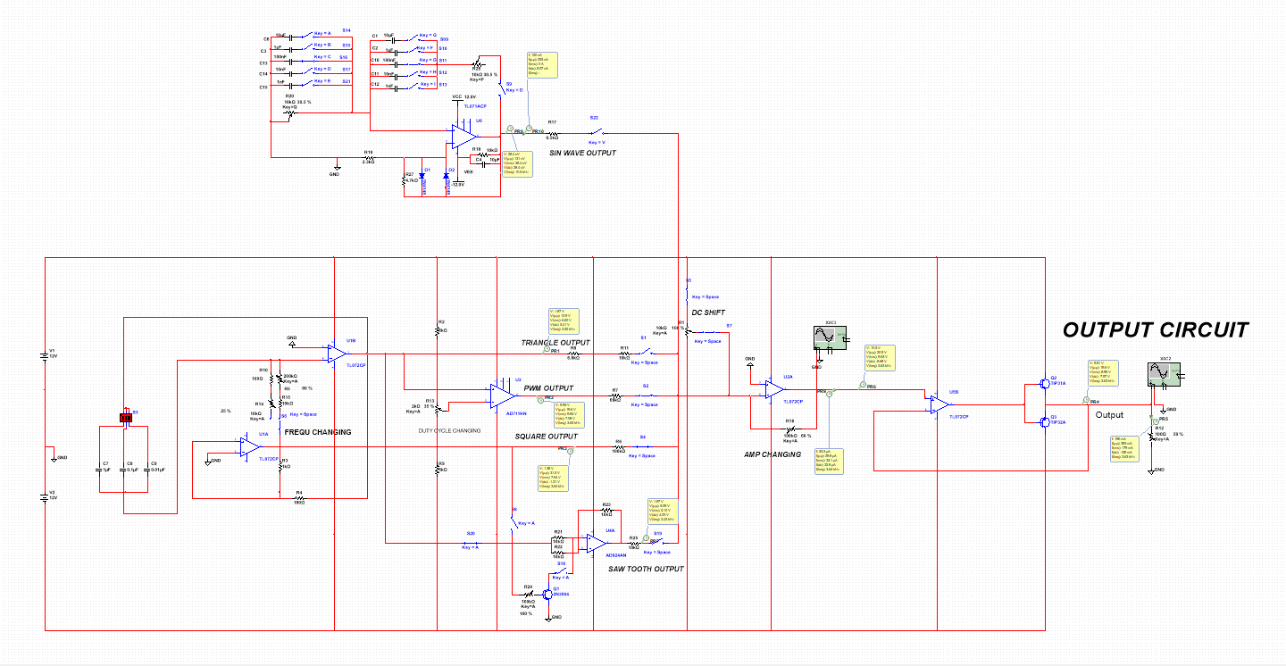
Multisim Schematic Diagram

Slide 12
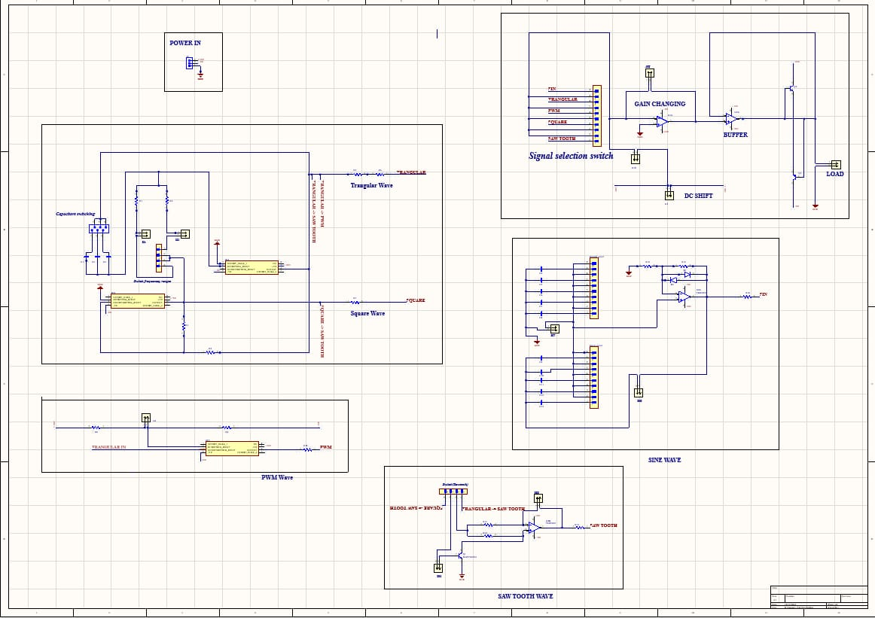
PCB Schematic Design

Slide 13
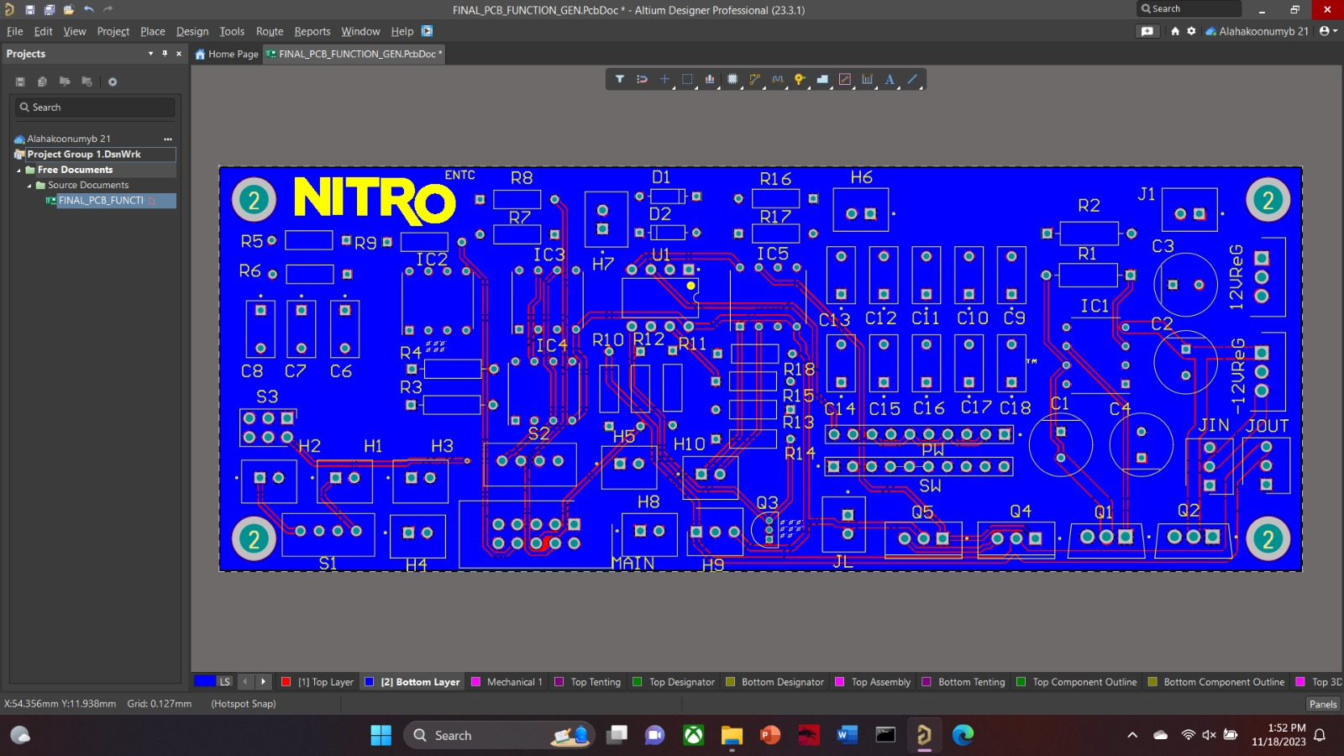
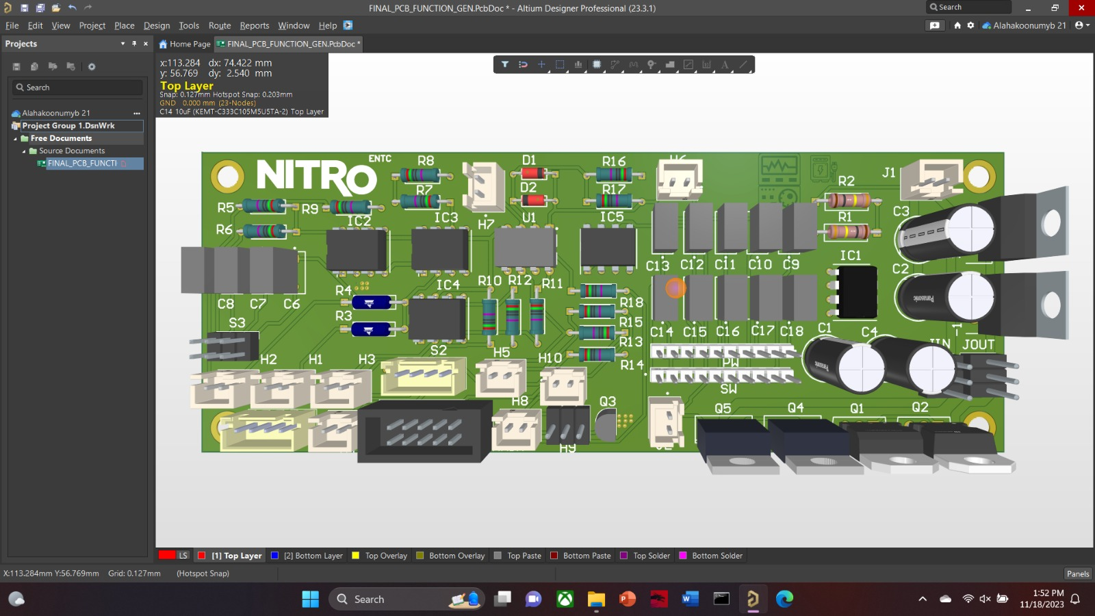
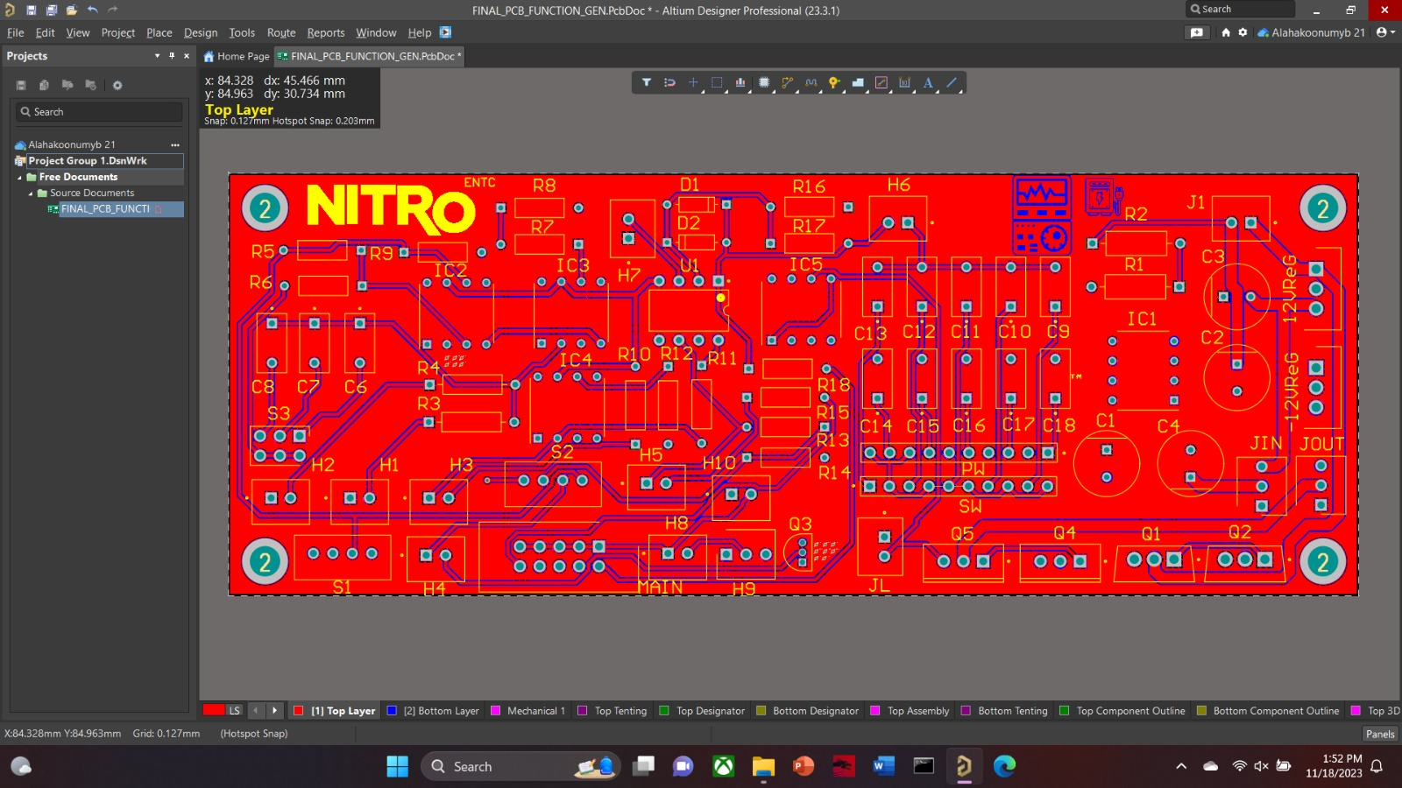
PCB Design

Slide 14
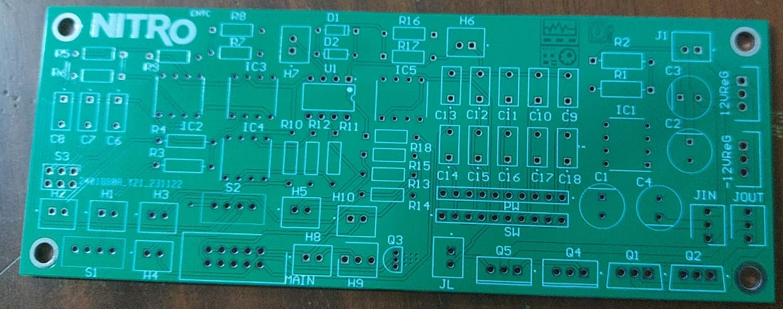
PCB

Slide 15
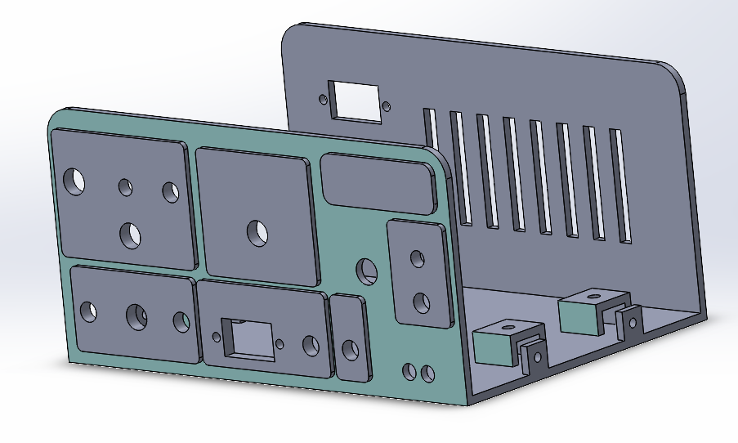
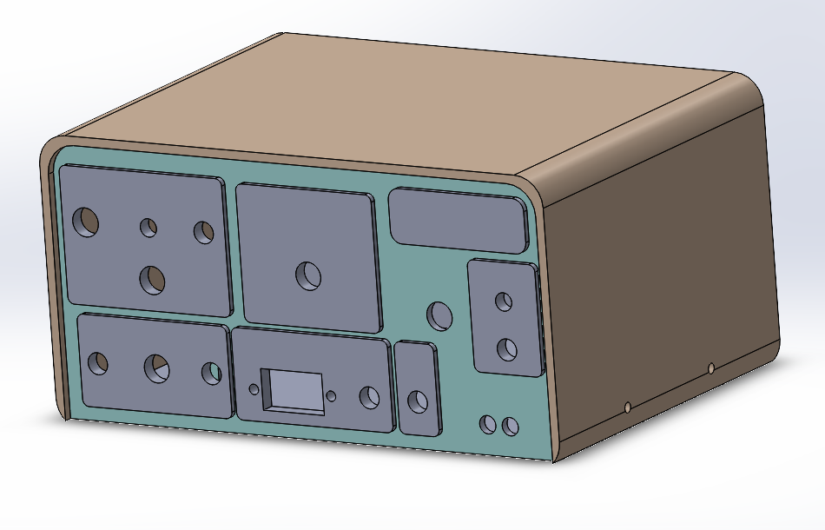
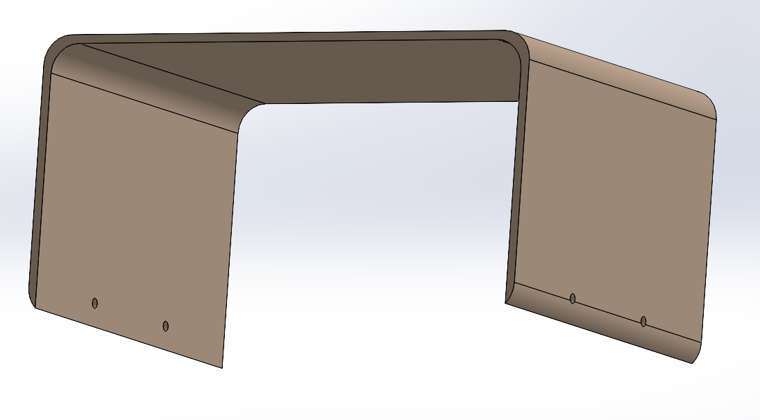
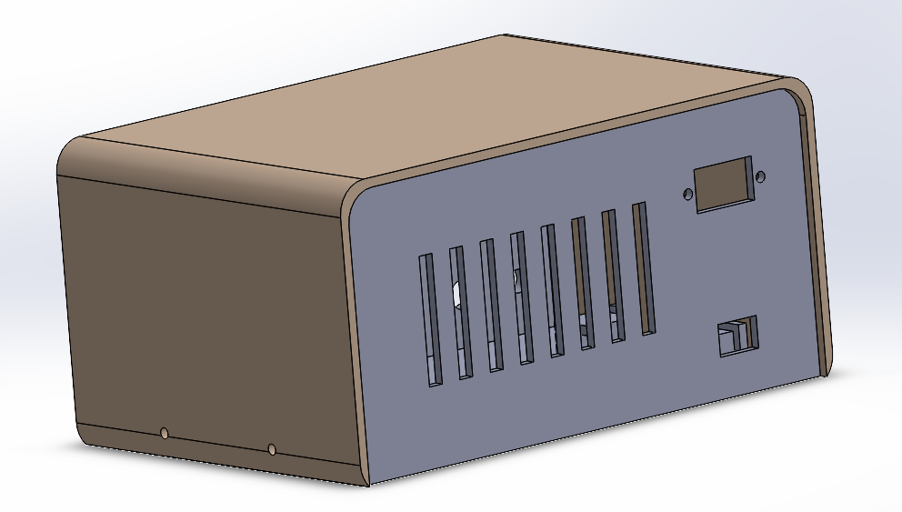
Enclosure

Slide 16
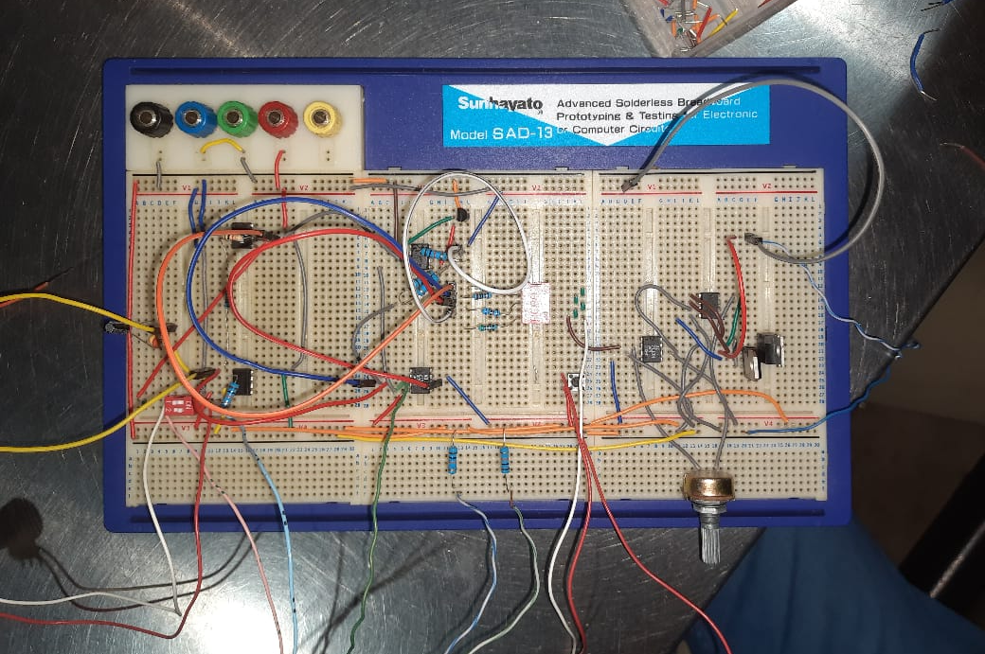
Testing & Debugging

Slide 17
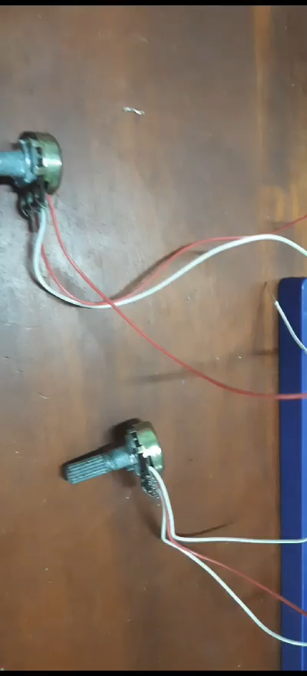
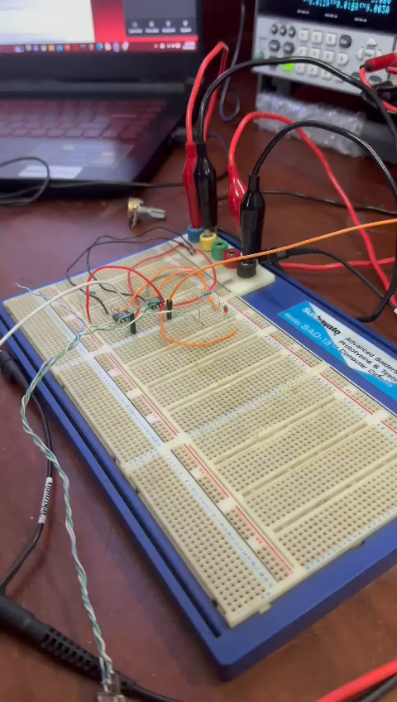

Slide 18
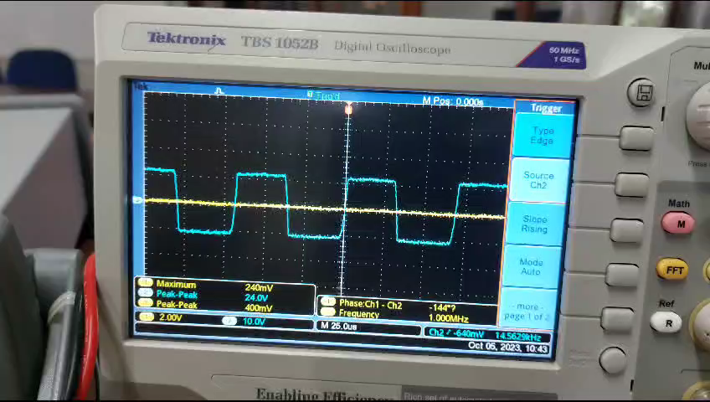

Slide 19
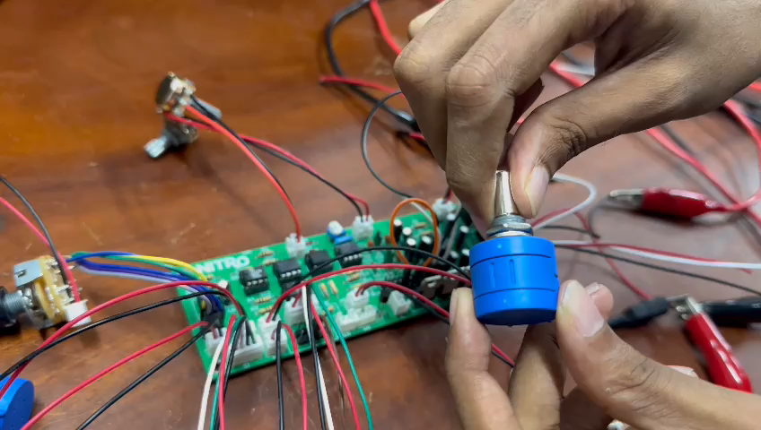
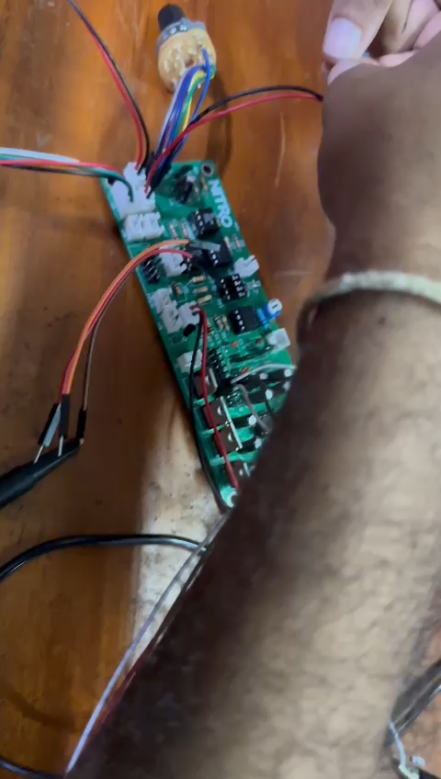
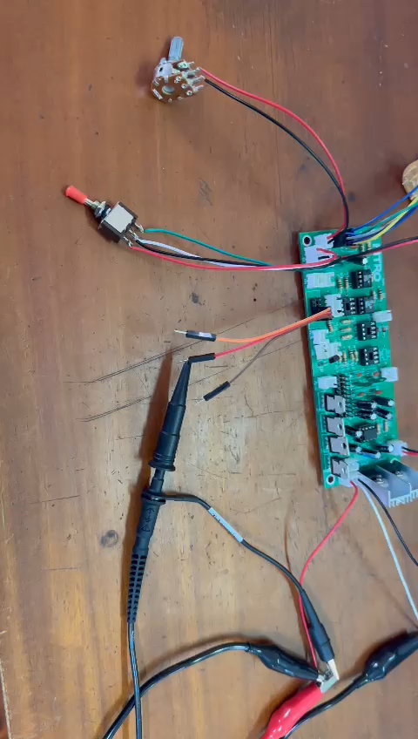

Slide 20
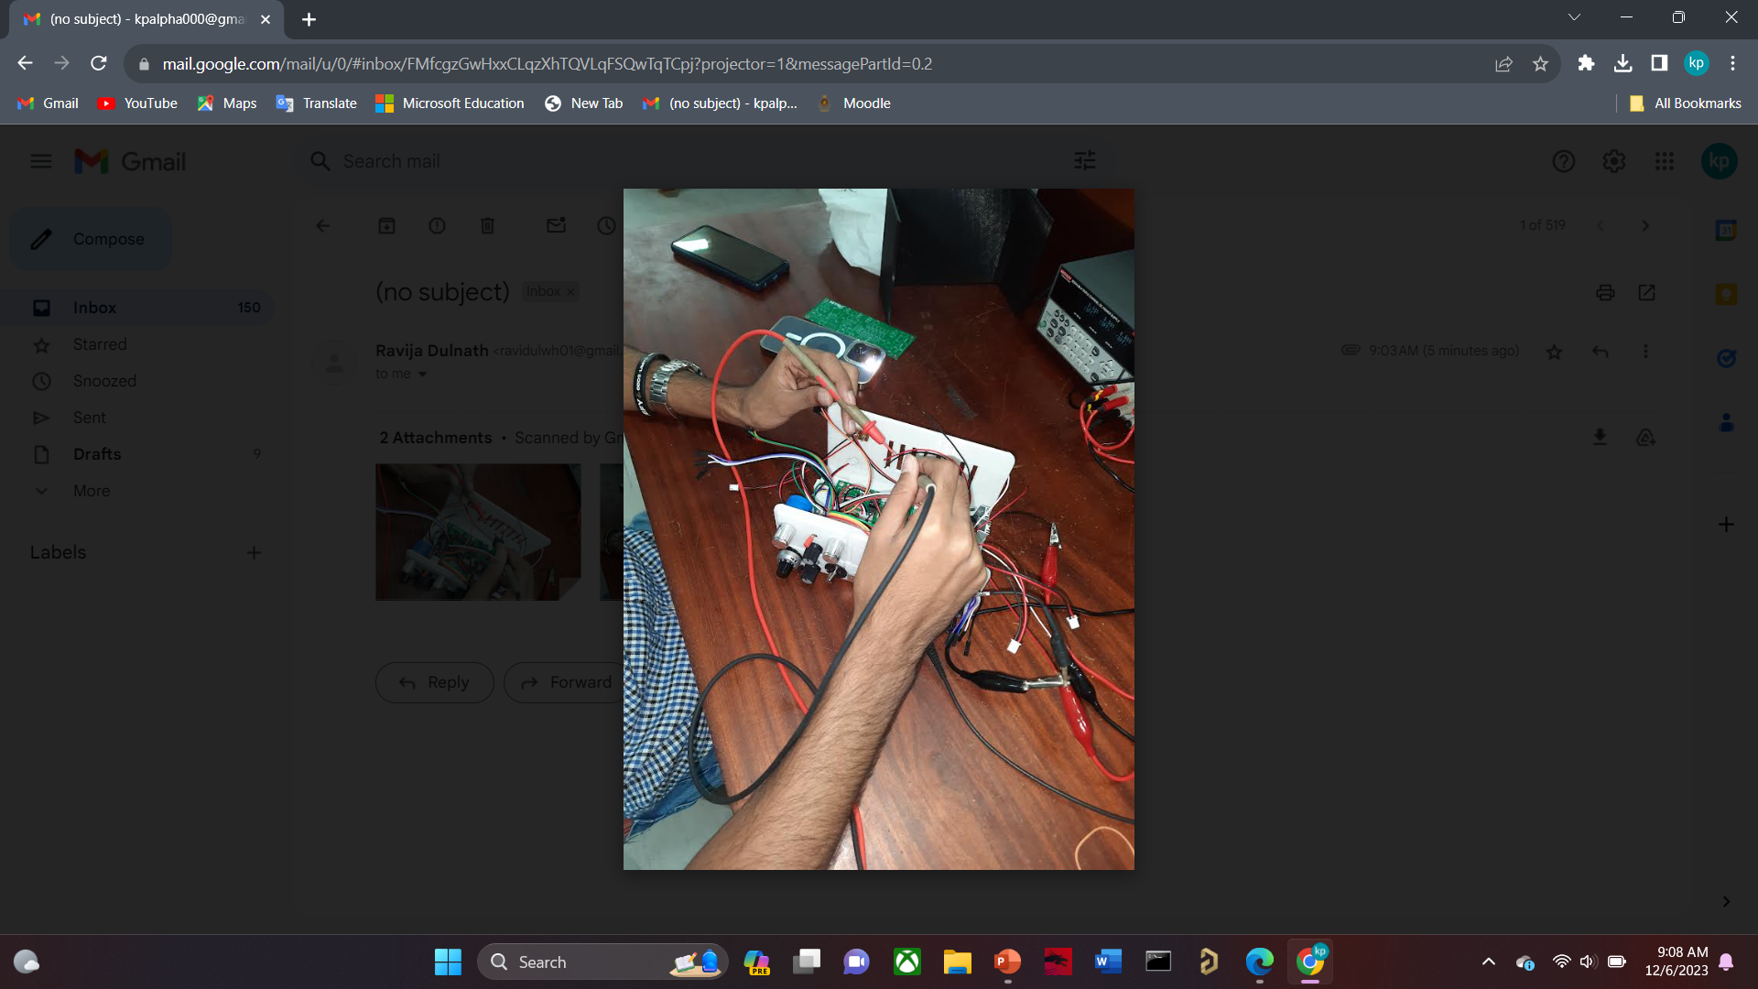
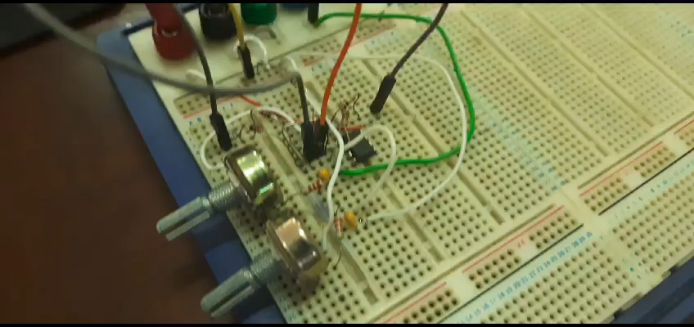

Slide 21
Bill of Quantities
Component | Quantity | Price Rs/=
AD711LN IC | 3 | 6300
Ad712JNZ | 1 | 2200
TL072CP IC | 3 | 270
Potentiometers | 7 | 2460
Switches | 7 | 720
TIP31c | 2 | 30
TIP32c | 2 | 24
2N3904 | 1 | 6
Capacitors, resistors, diodes and JST wires |  | 1500
3D Printing | - | 5200
PCB Design Cost | - | 3900
TOTAL |  | 22 610/=

Slide 22
Team Members & Task Allocation
ALAHAKOON U.M.Y.B. 210027C
Square, Trangular wave Generating Circuit and Altium Designing
DULNATH W.H.R. 210152E
Wein bridge oscillator Circuit, Circuit Simulations and Altium Designing
HANSINDU K.A.A. 210204R
PWM, Saw-Tooth Wave generator Circuit Testing
SHAMIKA K.A.M. 210600D
Amplifier, Output circuit and Enclosure designing

Slide 23
Thank You

